Slide 1
Classroom learning dynamics using a cellular automata spatiotemporal model comparing peer instruction and traditional instruction
Undergraduate Thesis Defense
National Institute of Physics
December 12, 2024, 10:30 AM
Clarence Ioakim T. Sy
BS Applied Physics
Instrumentation Physics Laboratory
National Institute of Physics
University of the Philippines Diliman
Adviser: Johnrob Y. Bantang, Ph.D.

Slide 2
Abstract
Peer instruction (PI) has recently become one of the popular means of classroom instruction in Physics Education. Such instruction method is vastly different from how classes are traditionally handled where the instructor conducts a lecture for the entire duration of the class. In this study, we model the transfer of knowledge within the class as a probabilistic cellular automata model and investigate the effects of different factors such as seating arrangements, size, learning rate, and heterogeneity on the classes’ overall learning efficiency in peer instruction. We compared the learning efficiency between the traditional learning model and the PI model. We found that larger class sizes sway the advantage towards traditional instruction, while increased learning rate heterogeneity favors PI. Additionally, an increase in the students’ effective learning rate benefits both traditional instruction and PI but in different ways. Classes under traditional instruction were found to have two stages of learning when heterogeneity was introduced: a fast initial stage and a slow final stage. On the other hand, learning trends in PI were generally unaffected by heterogeneity, having similar effects with the other factors we considered. Among the seating arrangements (SAs) we considered for PI, the inner corner SA performed the best in terms of both the time it takes for all the students to learn and the classroom’s learning rate. This result differs from previous studies where they found that the outer corner SA performed the best. The difference stems from the simplifications made in this model. We did not consider the orientation factor of each student, resulting in an isotropic system. Our model also uses binary values and does not consider the effect of aptitude similarity that have been described in previous studies. Despite these simplifications, our findings generally agree with previous studies and existing practices that PI performs similarly or better than traditional instruction and that a mix of traditional instruction and PI would be the optimal method of instruction. We offer insights based on the qualitative results of the model.

Slide 3
Outline
Methods of instruction
Homogenous classes
Heterogenous classes
Summary and conclusions
Comparison with other research

Slide 4
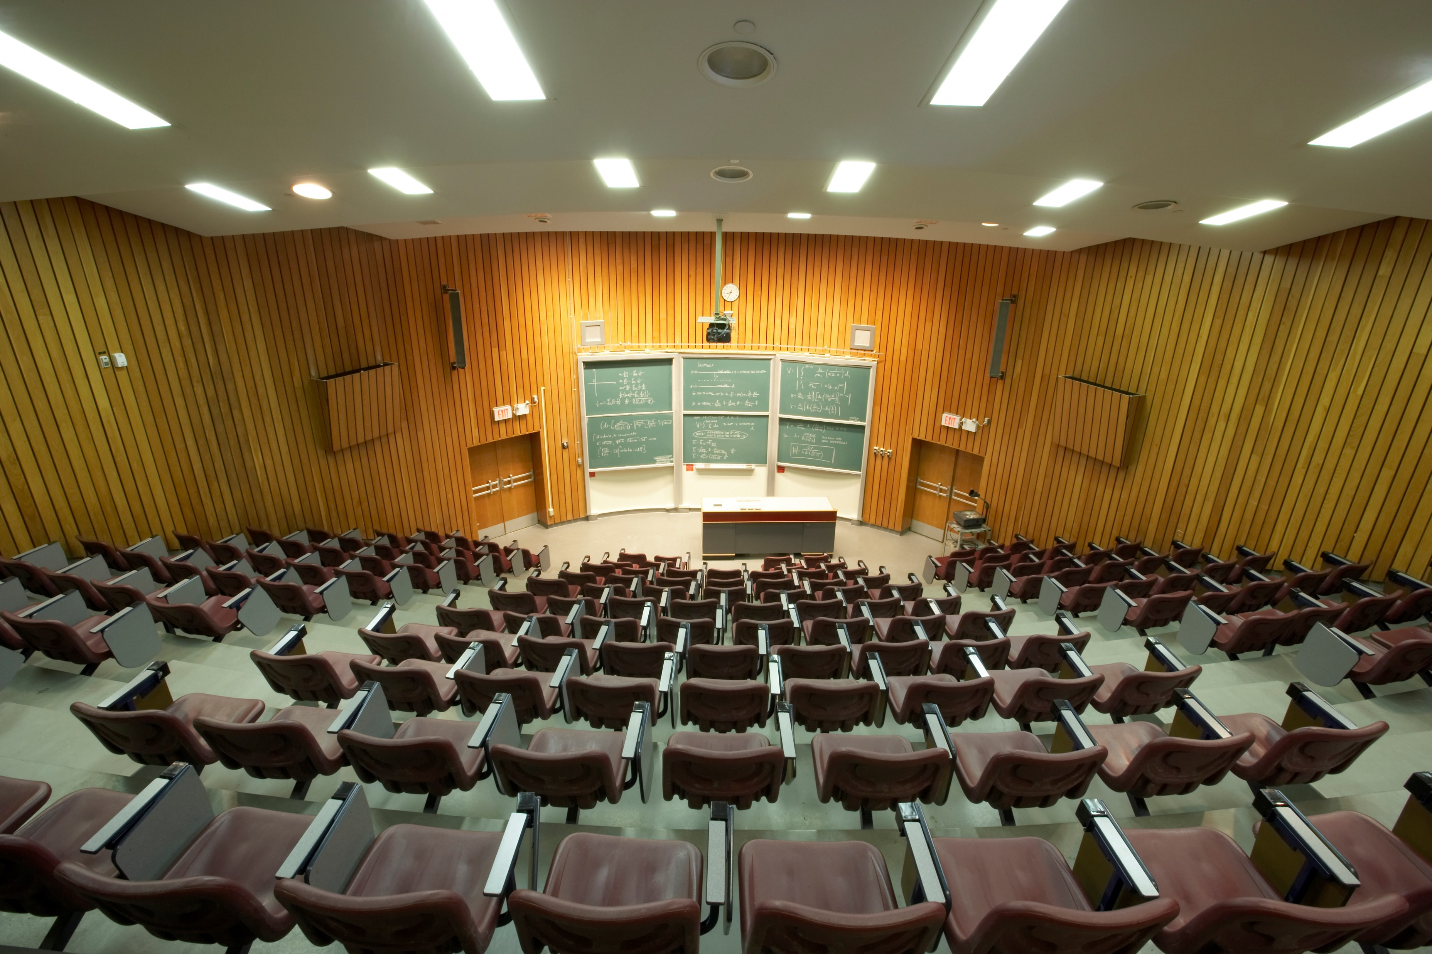

Slide 5


Traditional instruction vs peer instruction
Traditional instruction | Peer instruction
The instructor delivers a lecture to the whole class for the duration of the class time. | Advanced reading Short lecture Concept test (pre-test) Peer discussion Concept test (post-test)

Slide 6
Advantages of peer instruction (PI)
Better test scores
Higher for conceptual and quantitative problems
Fewer students scored extremely low
Students can learn even in naïve groups
Lack of background knowledge does not negatively impact PI
Reduced dropping rates
Crouch and Mazur, 2001; Lasry et. al., 2008; Thacker et. al. 1994
Smith et. al., 2009
Lasry et. al., 2008; Coletta and Phillips, 2005
Lasry et. al., 2008; Tobias, 1990

Slide 7

Existing mathematical models for PI
Differential equations (Pritchard, 2008)
No spatial component
Ising model (Bordogna and Albano, 2001 & 2003)
Difficult to incorporate different agent-agent interactions
Neural networks (Roxas, et. al., 2010)
Predictive
Relies on real data or an objective function

Slide 8
Research questions
How does the number of learned students develop over time?
Spatial position of high aptitude students in class
How does the positioning of learned students affect the learning rate of the class for peer instruction?
Learning rate
Advantages of methods of instruction
When is peer instruction better than traditional instruction?
Which factors lead to a difference in performance?

Slide 9


Binary state probabilistic CA model
The classroom is set to be a 2D square grid of varying lengths.
Students are either learned or not learned (state: 0 or 1) with varying individual learning rates.
The simulation is considered done when all students are learned.
The classroom is updated based on PCA rules to simulate the learning process

Slide 10
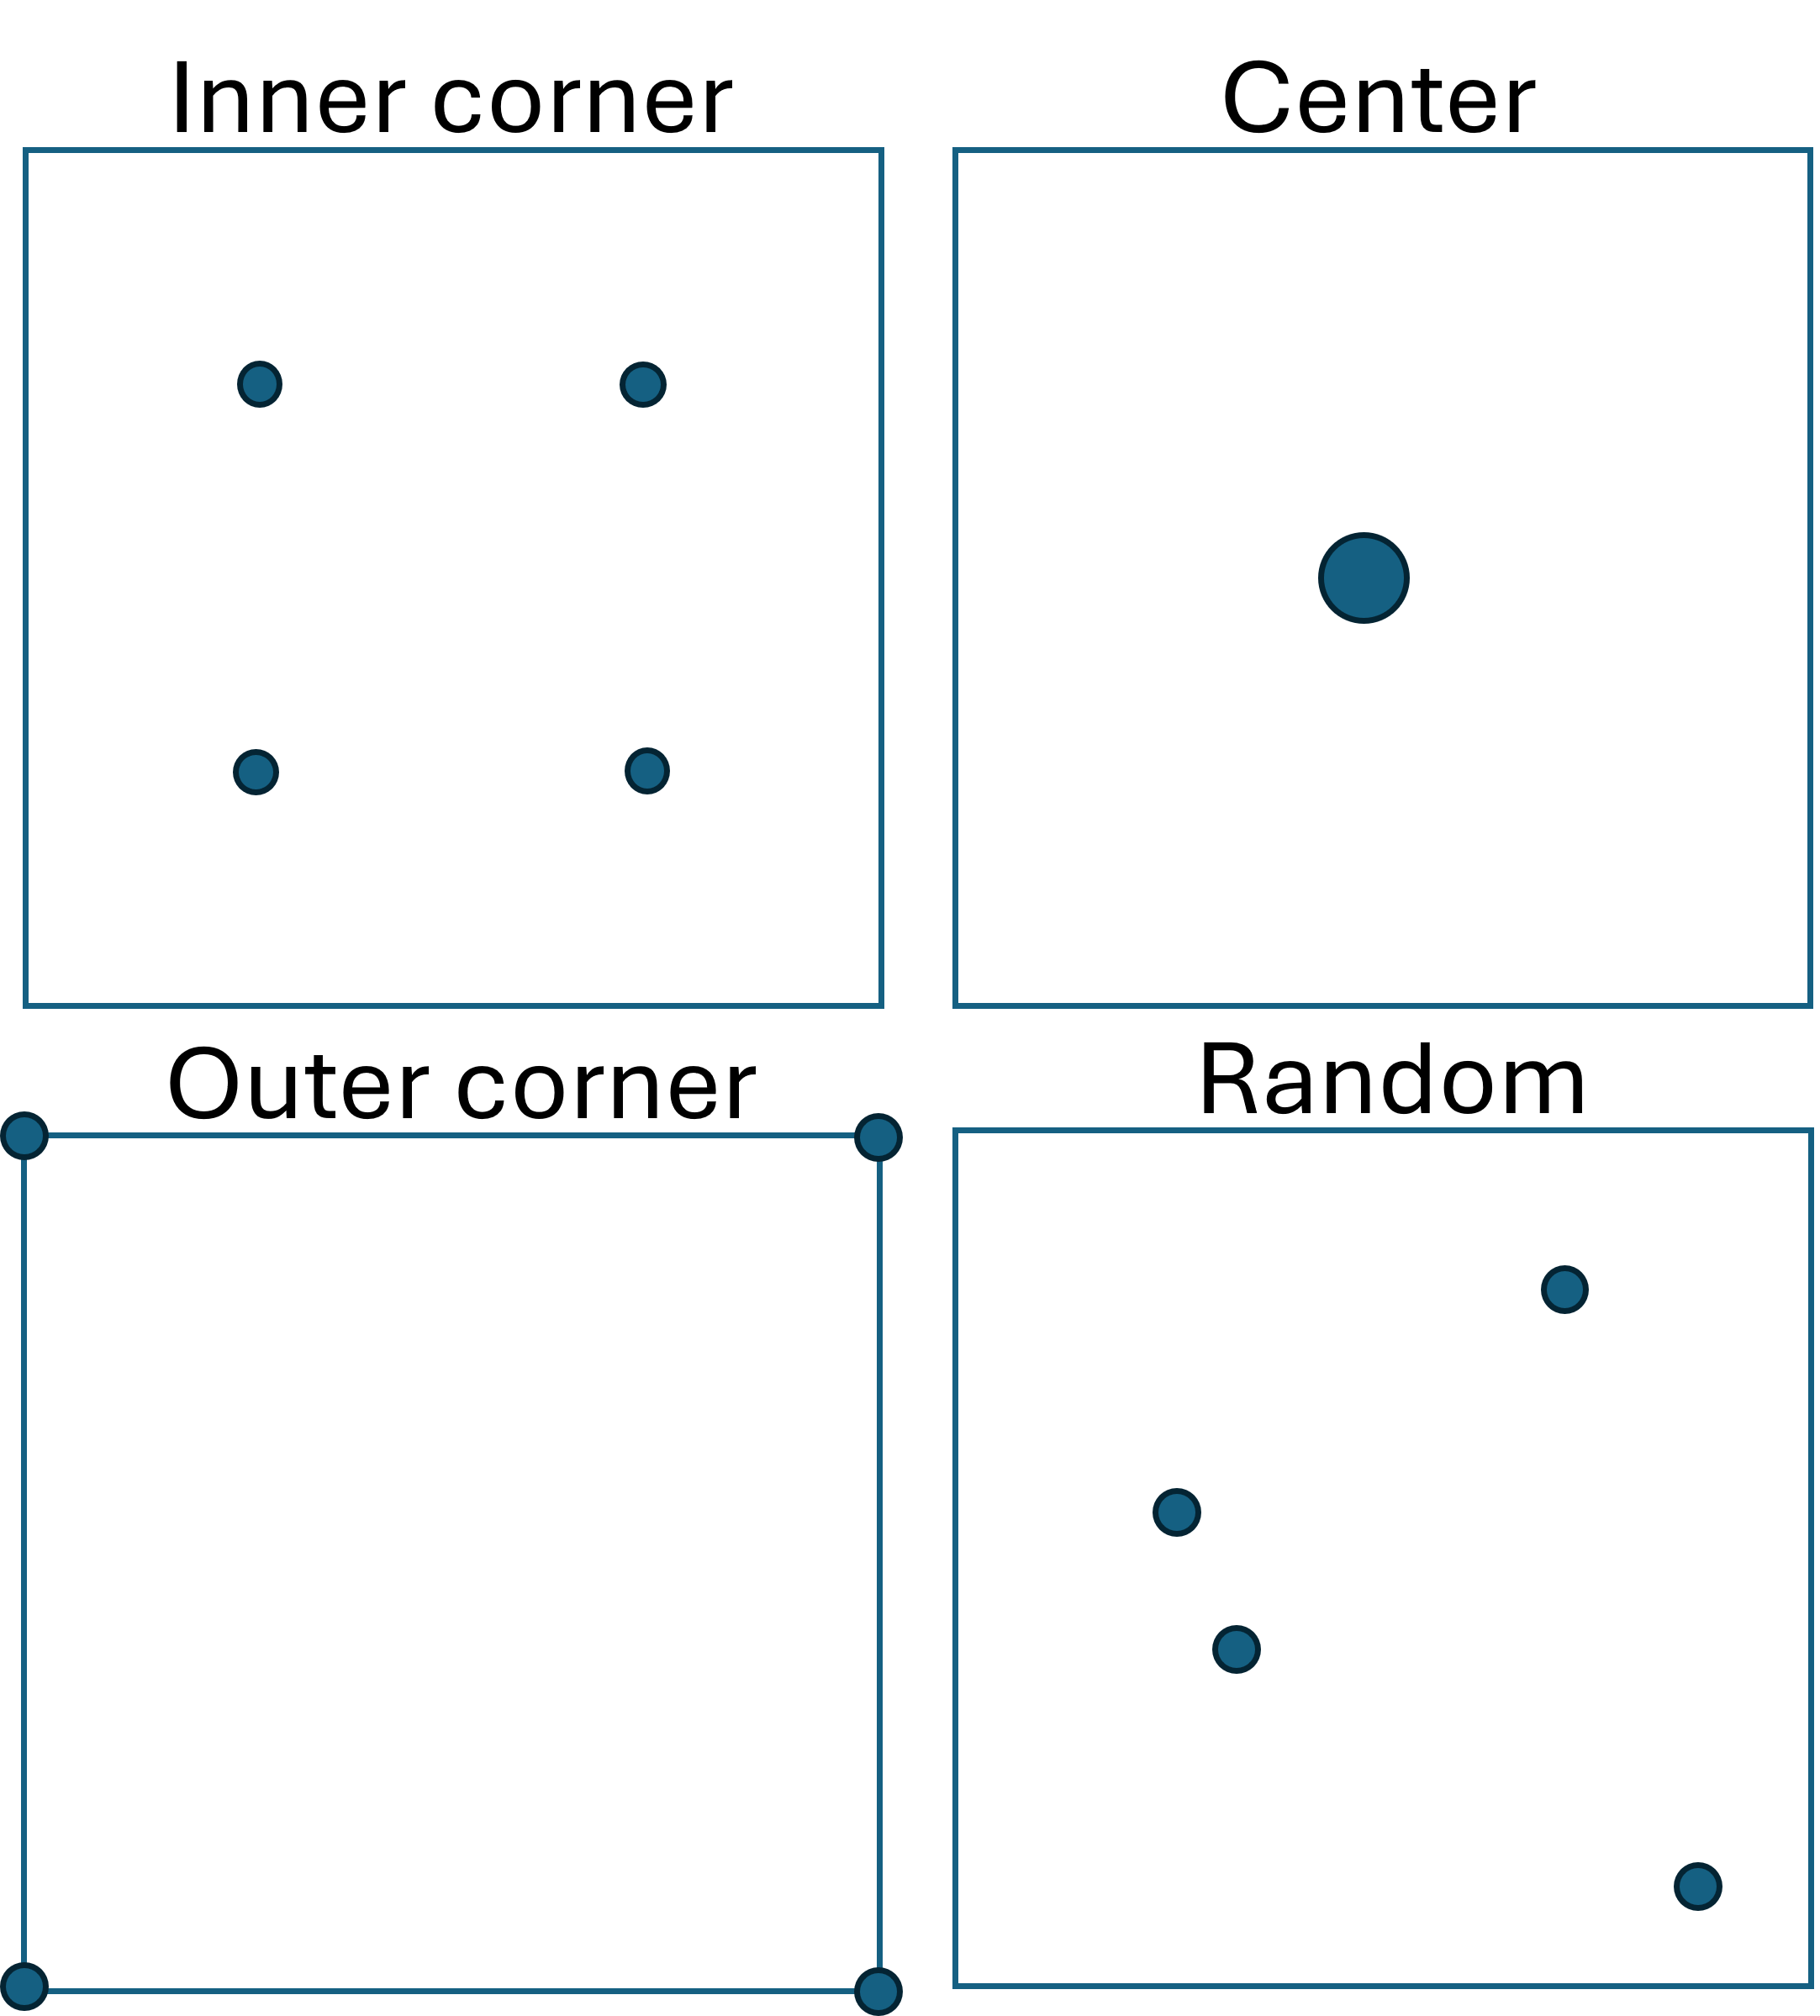
Different initial conditions for PI
- Location of learned students

Slide 11

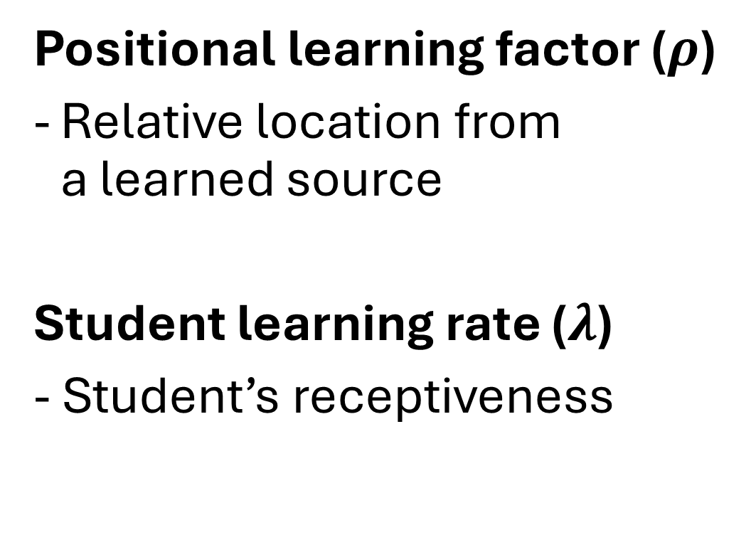
Factors affecting student learning
Positional learning factor ($ρ$)
Relative location from a learned source
Student learning rate ($λ$)
- Student’s receptiveness

Slide 12
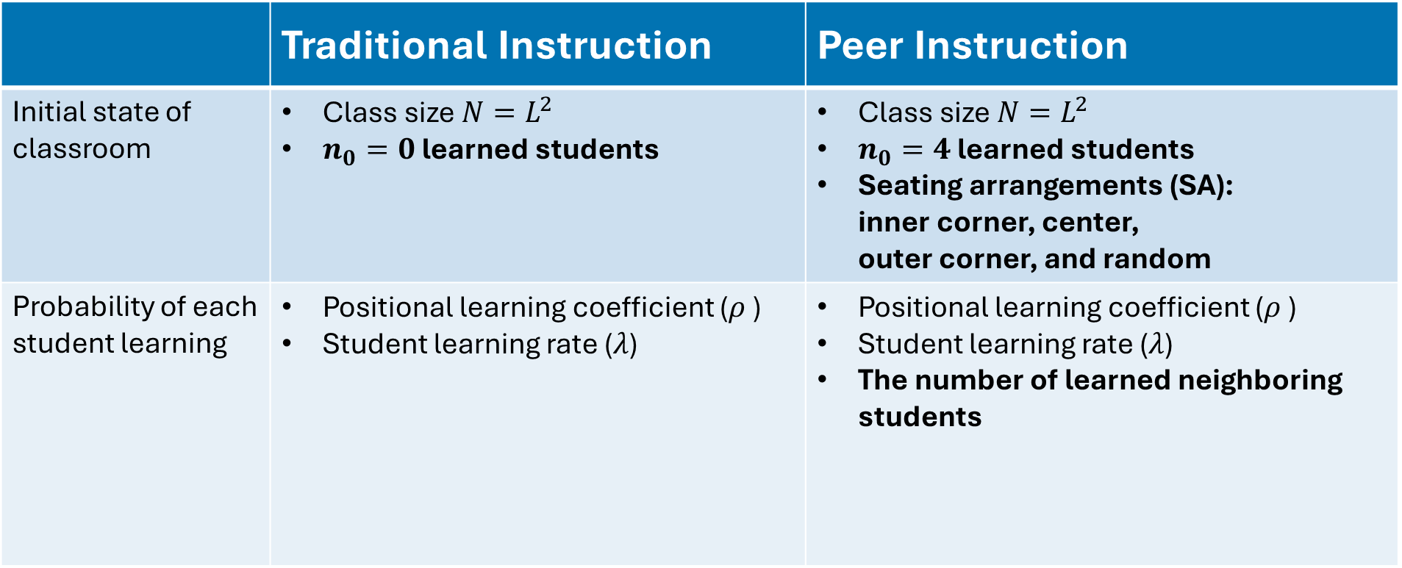
Summary of input parameters
 | Traditional Instruction | Peer Instruction
Initial state of classroom | Class size $N=L^{2}$ $n_{0}=0$ learned students | Class size $N=L^{2}$ $n_{0}=4$ learned students Seating arrangements (SA): inner corner, center, outer corner, and random
Probability of each student learning | Positional learning coefficient ($ρ$ ) Student learning rate ($λ$) | Positional learning coefficient ($ρ$ ) Student learning rate ($λ$) The number of learned neighboring students

Slide 13
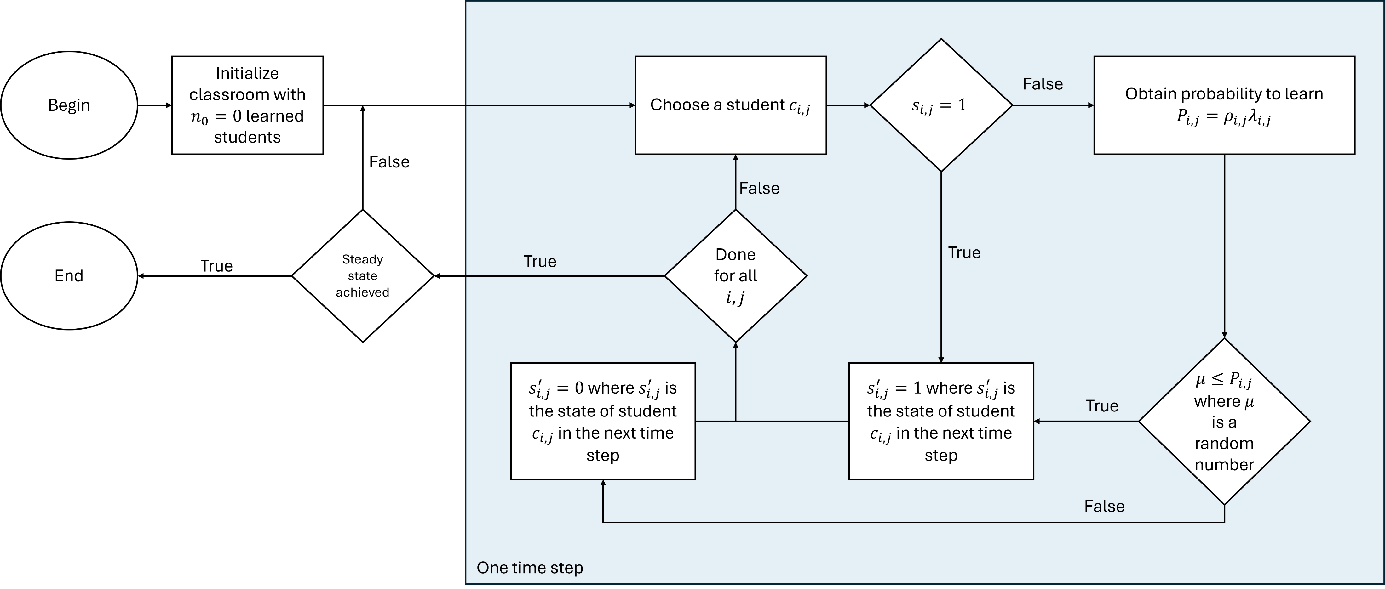
Flowchart for traditional instruction

Slide 14
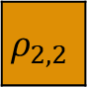
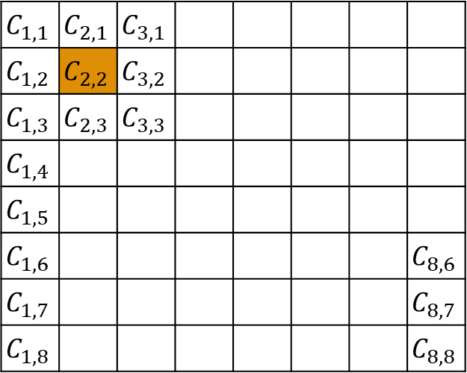
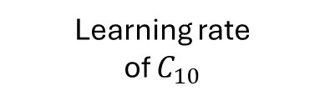

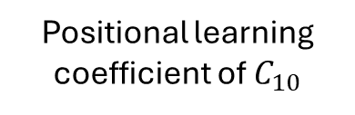

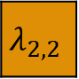
PCA model overview for traditional instruction
$$C_{1,1}$$ | $$C_{2,1}$$ | $$C_{3,1}$$
$$C_{1,2}$$ | $$C_{2,2}$$ | $$C_{3,2}$$
$$C_{1,3}$$ | $$C_{2,3}$$ | $$C_{3,3}$$
$$C_{1,4}$$
$$C_{1,5}$$
$$C_{1,6}$$ |  |  |  |  |  |  | $$C_{8,6}$$
$$C_{1,7}$$ |  |  |  |  |  |  | $$C_{8,7}$$
$$C_{1,8}$$ |  |  |  |  |  |  | $$C_{8,8}$$
$$ρ_{2,2}$$
$$⊙$$
$$λ_{2,2}$$
Positional learning coefficient of $C_{10}$
Learning rate of $C_{10}$
$$P_{ij}=ρ_{i,j}λ_{i,j}$$
Learning probability:
Classroom represented as lattice of cells

Slide 15
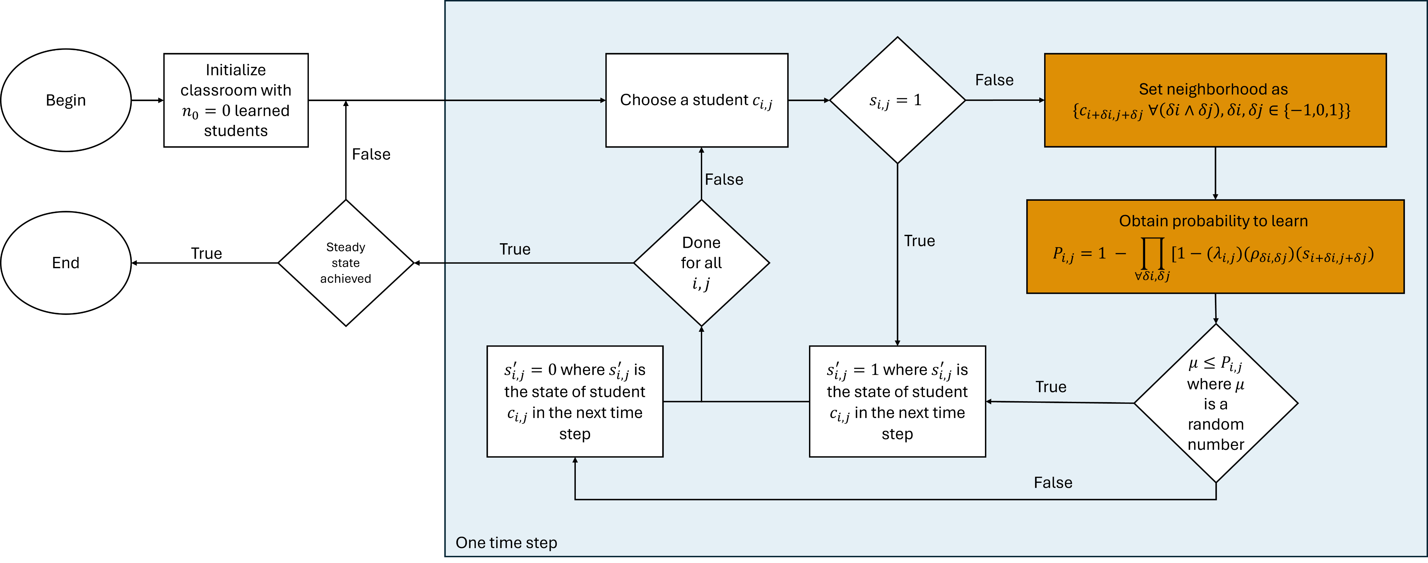
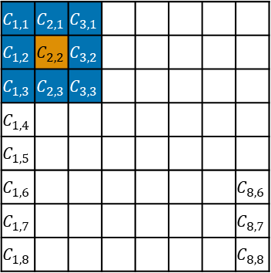
Flowchart for PI
$$C_{1,1}$$ | $$C_{2,1}$$ | $$C_{3,1}$$
$$C_{1,2}$$ | $$C_{2,2}$$ | $$C_{3,2}$$
$$C_{1,3}$$ | $$C_{2,3}$$ | $$C_{3,3}$$
$$C_{1,4}$$
$$C_{1,5}$$
$$C_{1,6}$$ |  |  |  |  |  |  | $$C_{8,6}$$
$$C_{1,7}$$ |  |  |  |  |  |  | $$C_{8,7}$$
$$C_{1,8}$$ |  |  |  |  |  |  | $$C_{8,8}$$

Slide 16
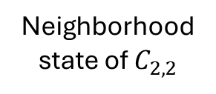
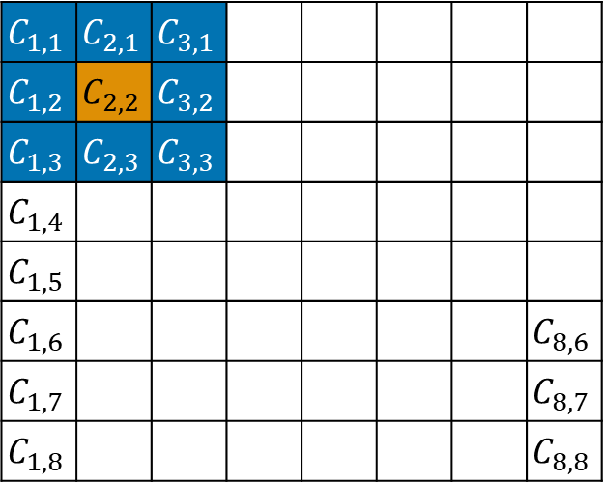

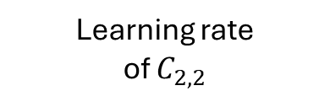
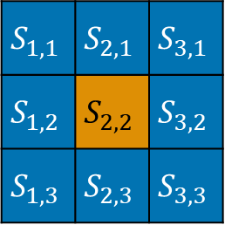

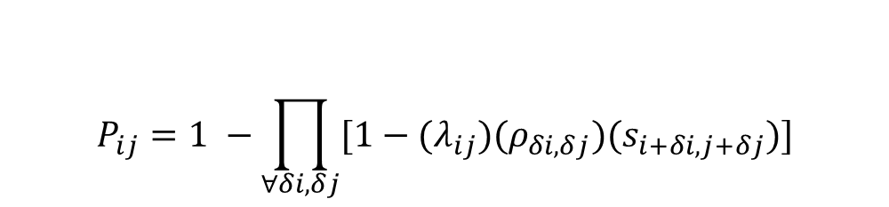
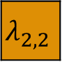
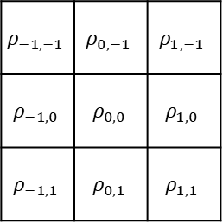
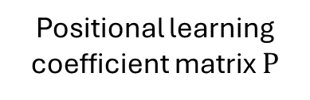
PCA model overview for PI
$$S_{1,1}$$ | $$S_{2,1}$$ | $$S_{3,1}$$
$$S_{1,2}$$ | $$S_{2,2}$$ | $$S_{3,2}$$
$$S_{1,3}$$ | $$S_{2,3}$$ | $$S_{3,3}$$
$$ρ_{−1,−1}$$ | $$ρ_{0,−1}$$ | $$ρ_{1,−1}$$
$$ρ_{−1,0}$$ | $$ρ_{0,0}$$ | $$ρ_{1,0}$$
$$ρ_{−1,1}$$ | $$ρ_{0,1}$$ | $$ρ_{1,1}$$
$$C_{1,1}$$ | $$C_{2,1}$$ | $$C_{3,1}$$
$$C_{1,2}$$ | $$C_{2,2}$$ | $$C_{3,2}$$
$$C_{1,3}$$ | $$C_{2,3}$$ | $$C_{3,3}$$
$$C_{1,4}$$
$$C_{1,5}$$
$$C_{1,6}$$ |  |  |  |  |  |  | $$C_{8,6}$$
$$C_{1,7}$$ |  |  |  |  |  |  | $$C_{8,7}$$
$$C_{1,8}$$ |  |  |  |  |  |  | $$C_{8,8}$$
$$⊙$$
$$⊙$$
$$λ_{2,2}$$
Neighborhood state of $C_{2,2}$
Positional learning coefficient matrix $Ρ$
Learning rate of $C_{2,2}$
$$P_{ij}=1 −\prod_{∀δi,δj}{[1−{(λ}_{ij})(ρ_{δi, δj})(s_{i+δi, j+δj})]}$$
Learning probability:
Classroom represented as lattice of cells

Slide 17
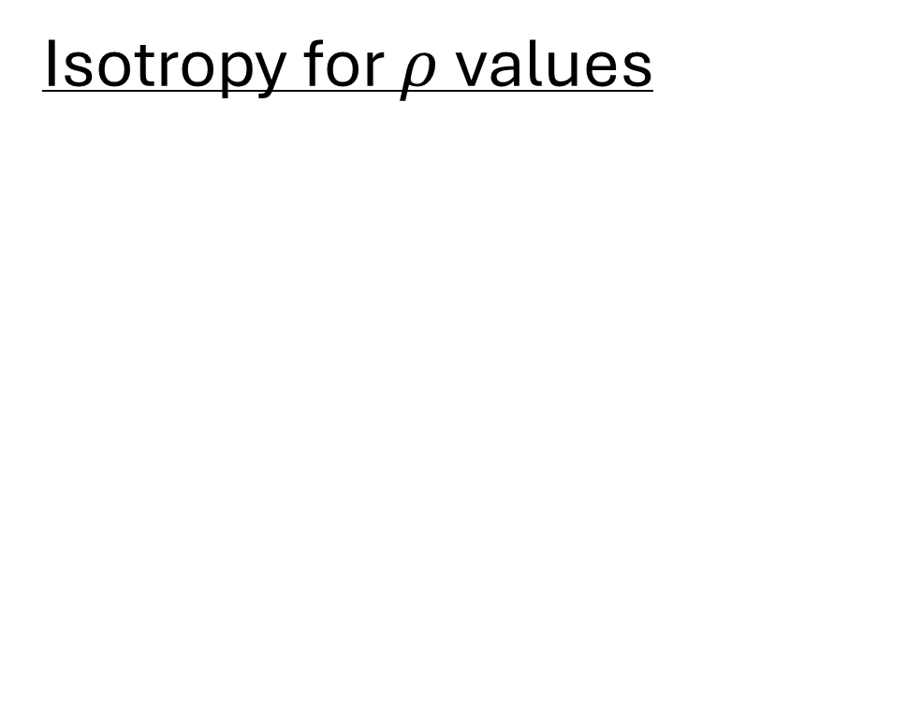
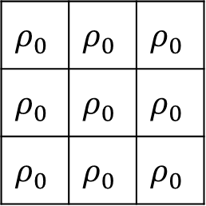
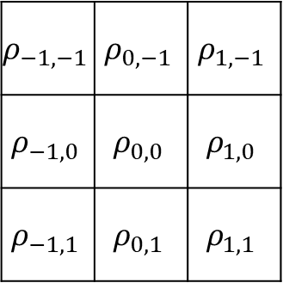
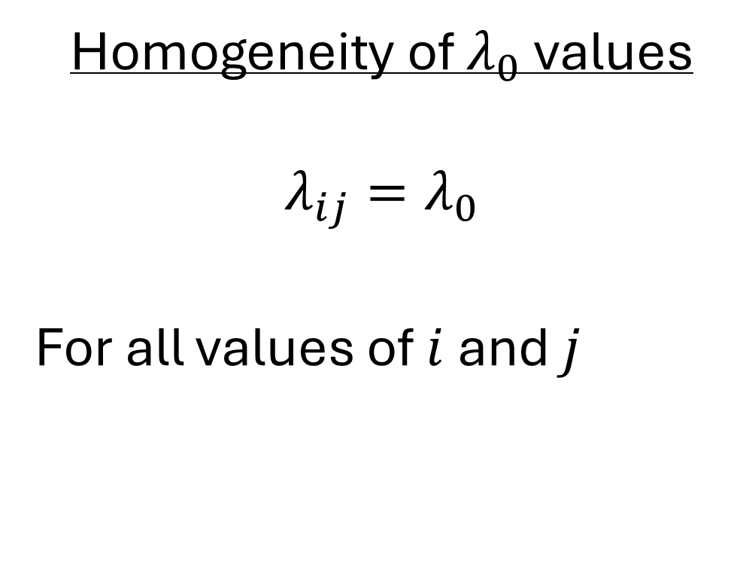
Model assumption
Isotropy for $ρ$values
Homogeneity of $λ_{0}$ values
$$λ_{ij}=λ_{0}$$
For all values of $i$ and $j$
$$ρ_{−1,−1}$$ | $$ρ_{0,−1}$$ | $$ρ_{1,−1}$$
$$ρ_{−1,0}$$ | $$ρ_{0,0}$$ | $$ρ_{1,0}$$
$$ρ_{−1,1}$$ | $$ρ_{0,1}$$ | $$ρ_{1,1}$$
$$ρ_{0}$$ | $$ρ_{0}$$ | $$ρ_{0}$$
$$ρ_{0}$$ | $$ρ_{0}$$ | $$ρ_{0}$$
$$ρ_{0}$$ | $$ρ_{0}$$ | $$ρ_{0}$$

Slide 18



Sample progression of states
$$t=0$$
$$t=1$$
$$t=2$$
Previously learned students
Newly learned students

Slide 19
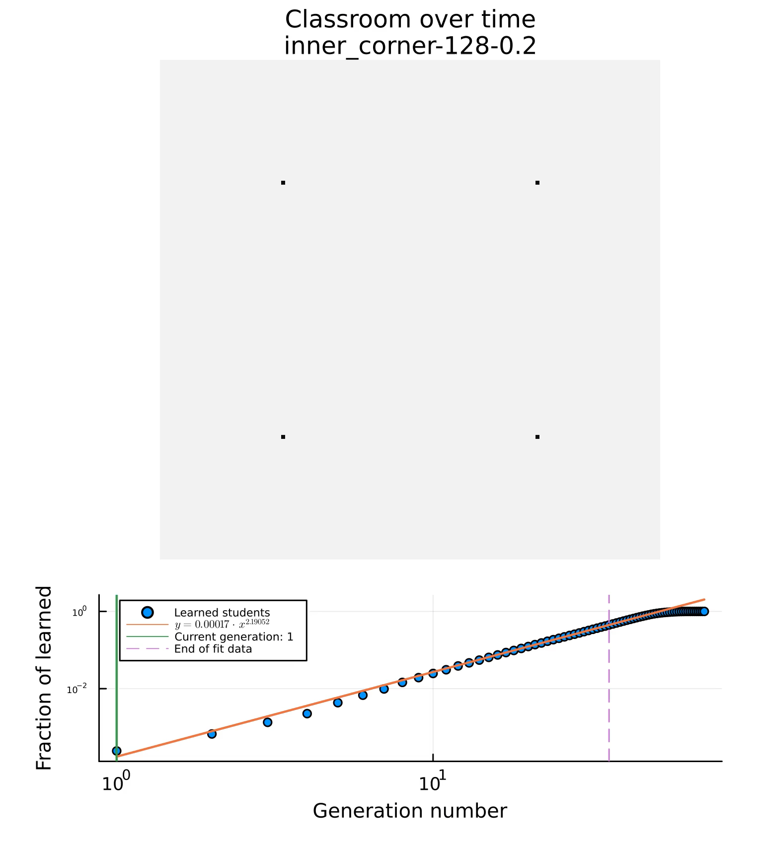
Sample progression of states continued
$$L=128, ρ_{0}=0.2, λ_{0}=1$$
Current time step:

Slide 20
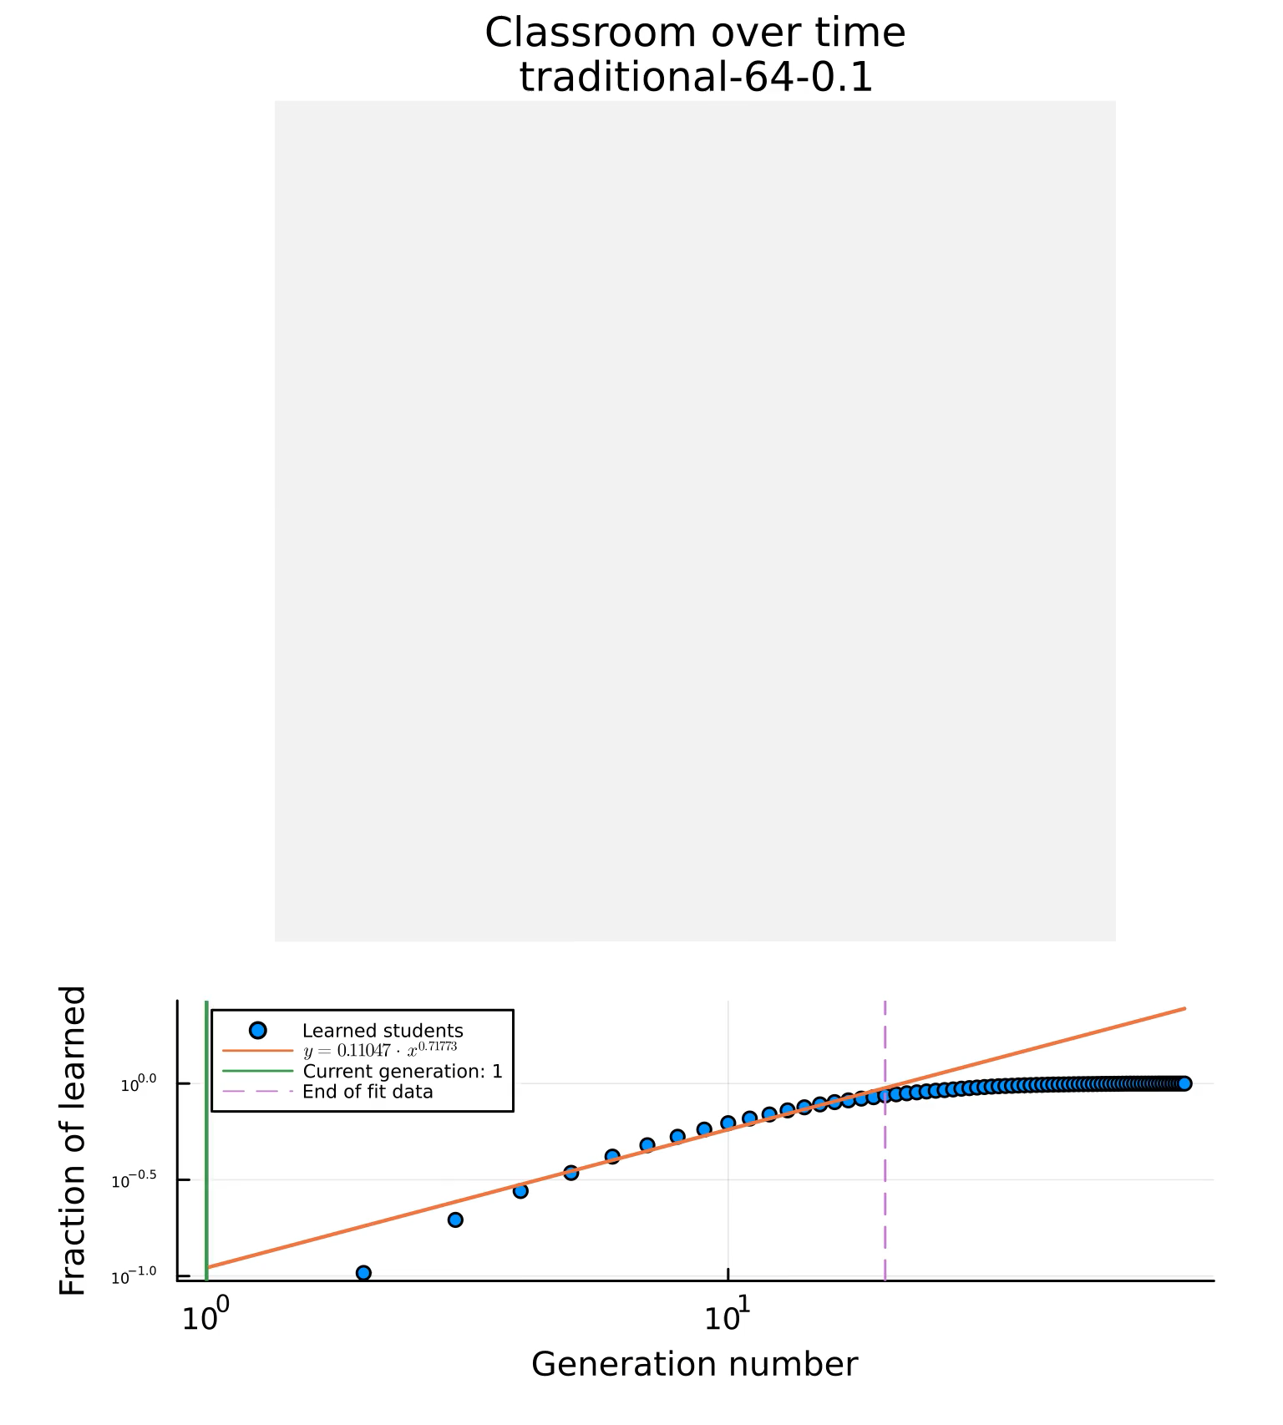
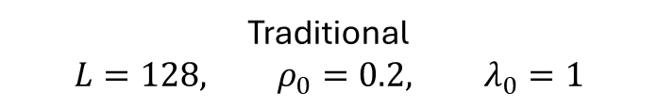
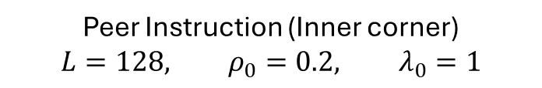
Progression of states for traditional and PI
Traditional
$$L=128, ρ_{0}=0.2, λ_{0}=1$$
Peer Instruction (Inner corner)
$$L=128, ρ_{0}=0.2, λ_{0}=1$$
Current time step:
Current time step:

Slide 21


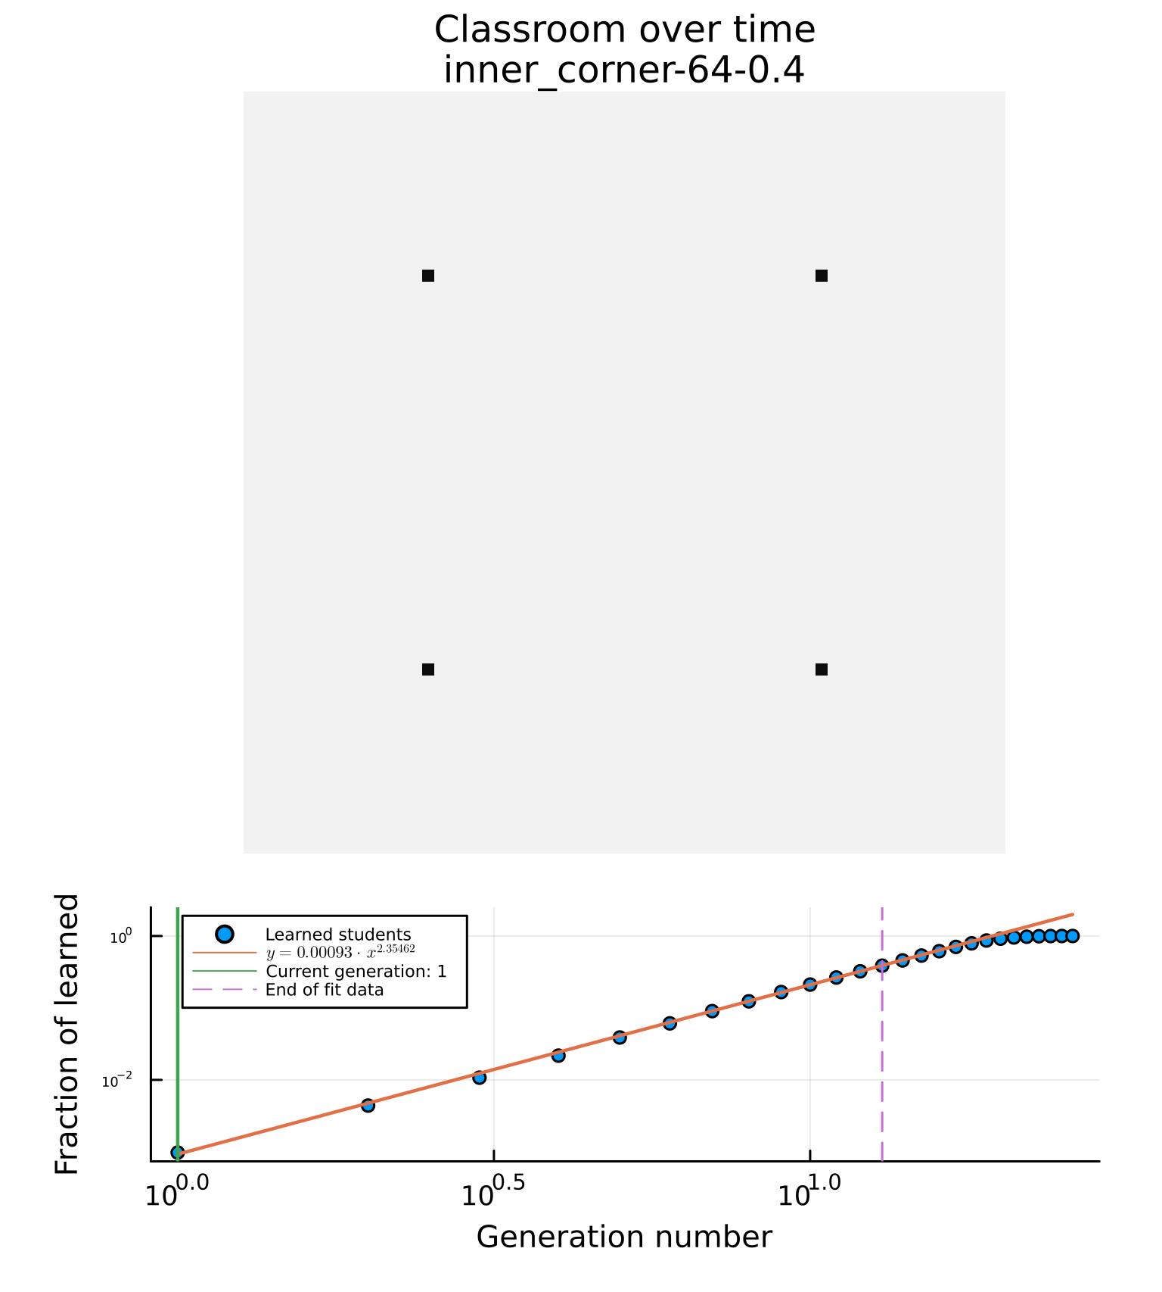
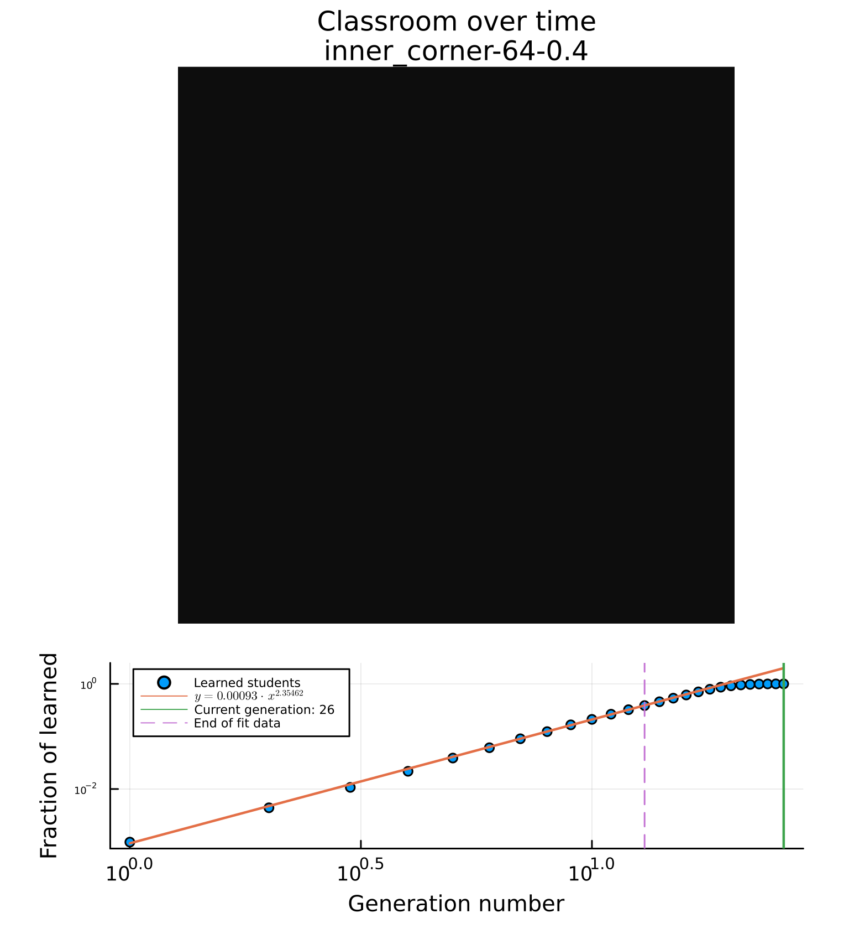

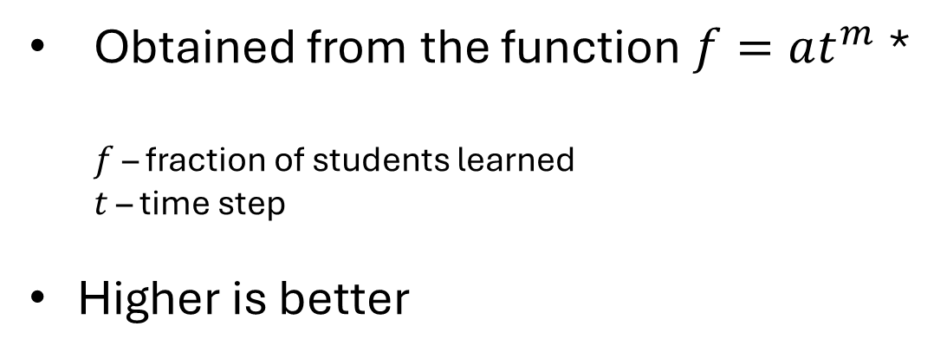
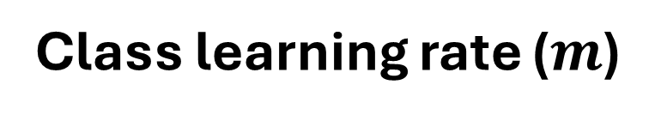
Performance parameters
Time to learn ($t_{max}$)
Class learning rate ($m$)
Time until all students are learned
Lower is better
Obtained from the function $f=at^{m}$ *
$f$ – fraction of students learned
$t$ – time step
Higher is better

Slide 22
Performance parameters from data

Slide 23
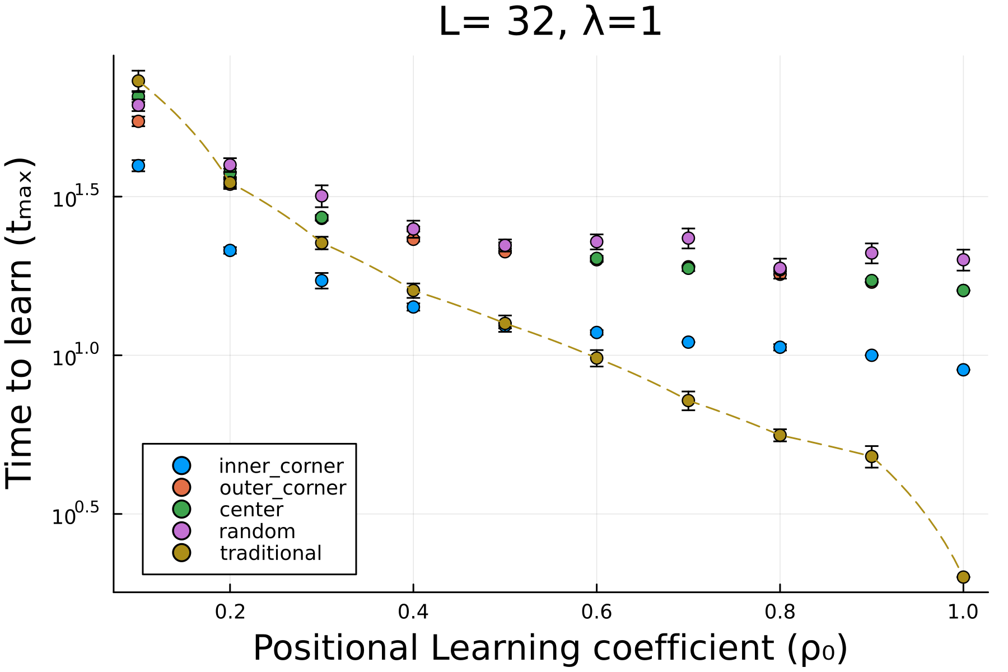
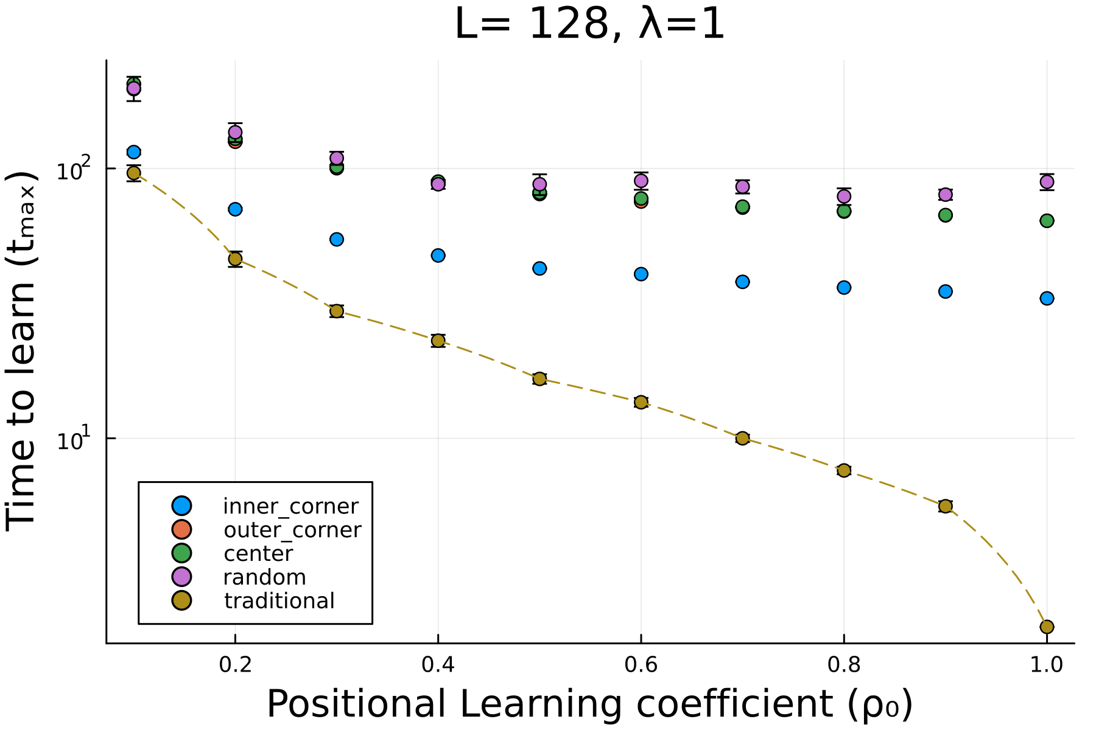
Inner corner performs the best for PI
Small class
Big class
*Lower is better

Slide 24
PI performs better for small slow class sizes
Small class
Big class
*Lower is better

Slide 25
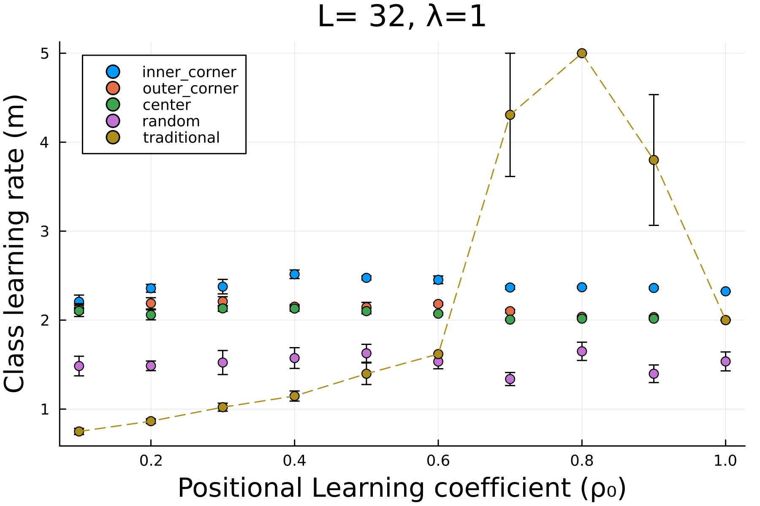
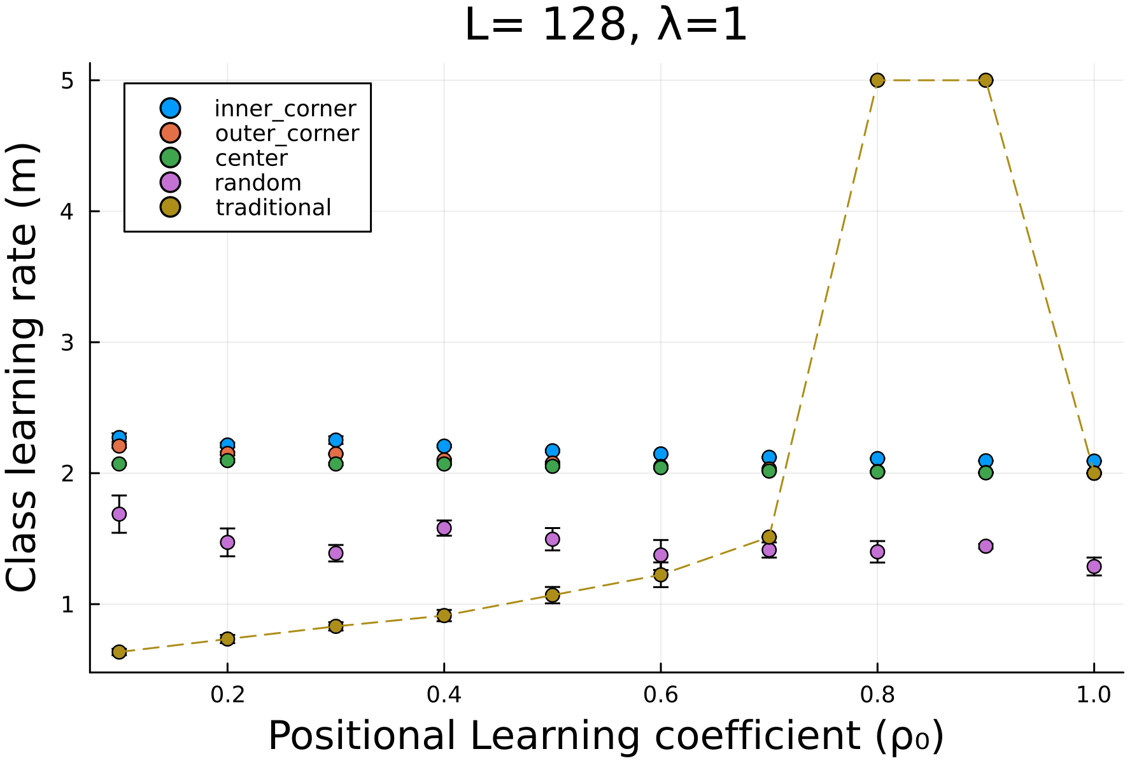
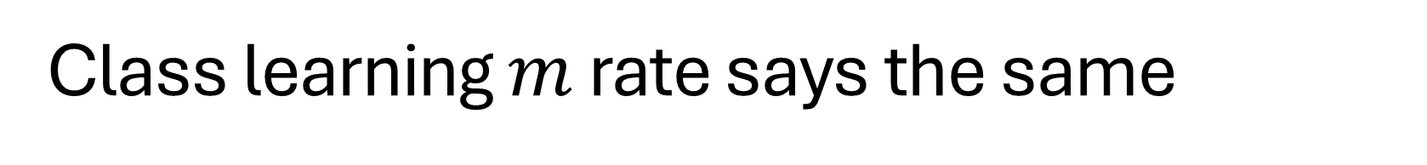
Class learning $m$ rate says the same
Small class
Big class
*Higher is better

Slide 26
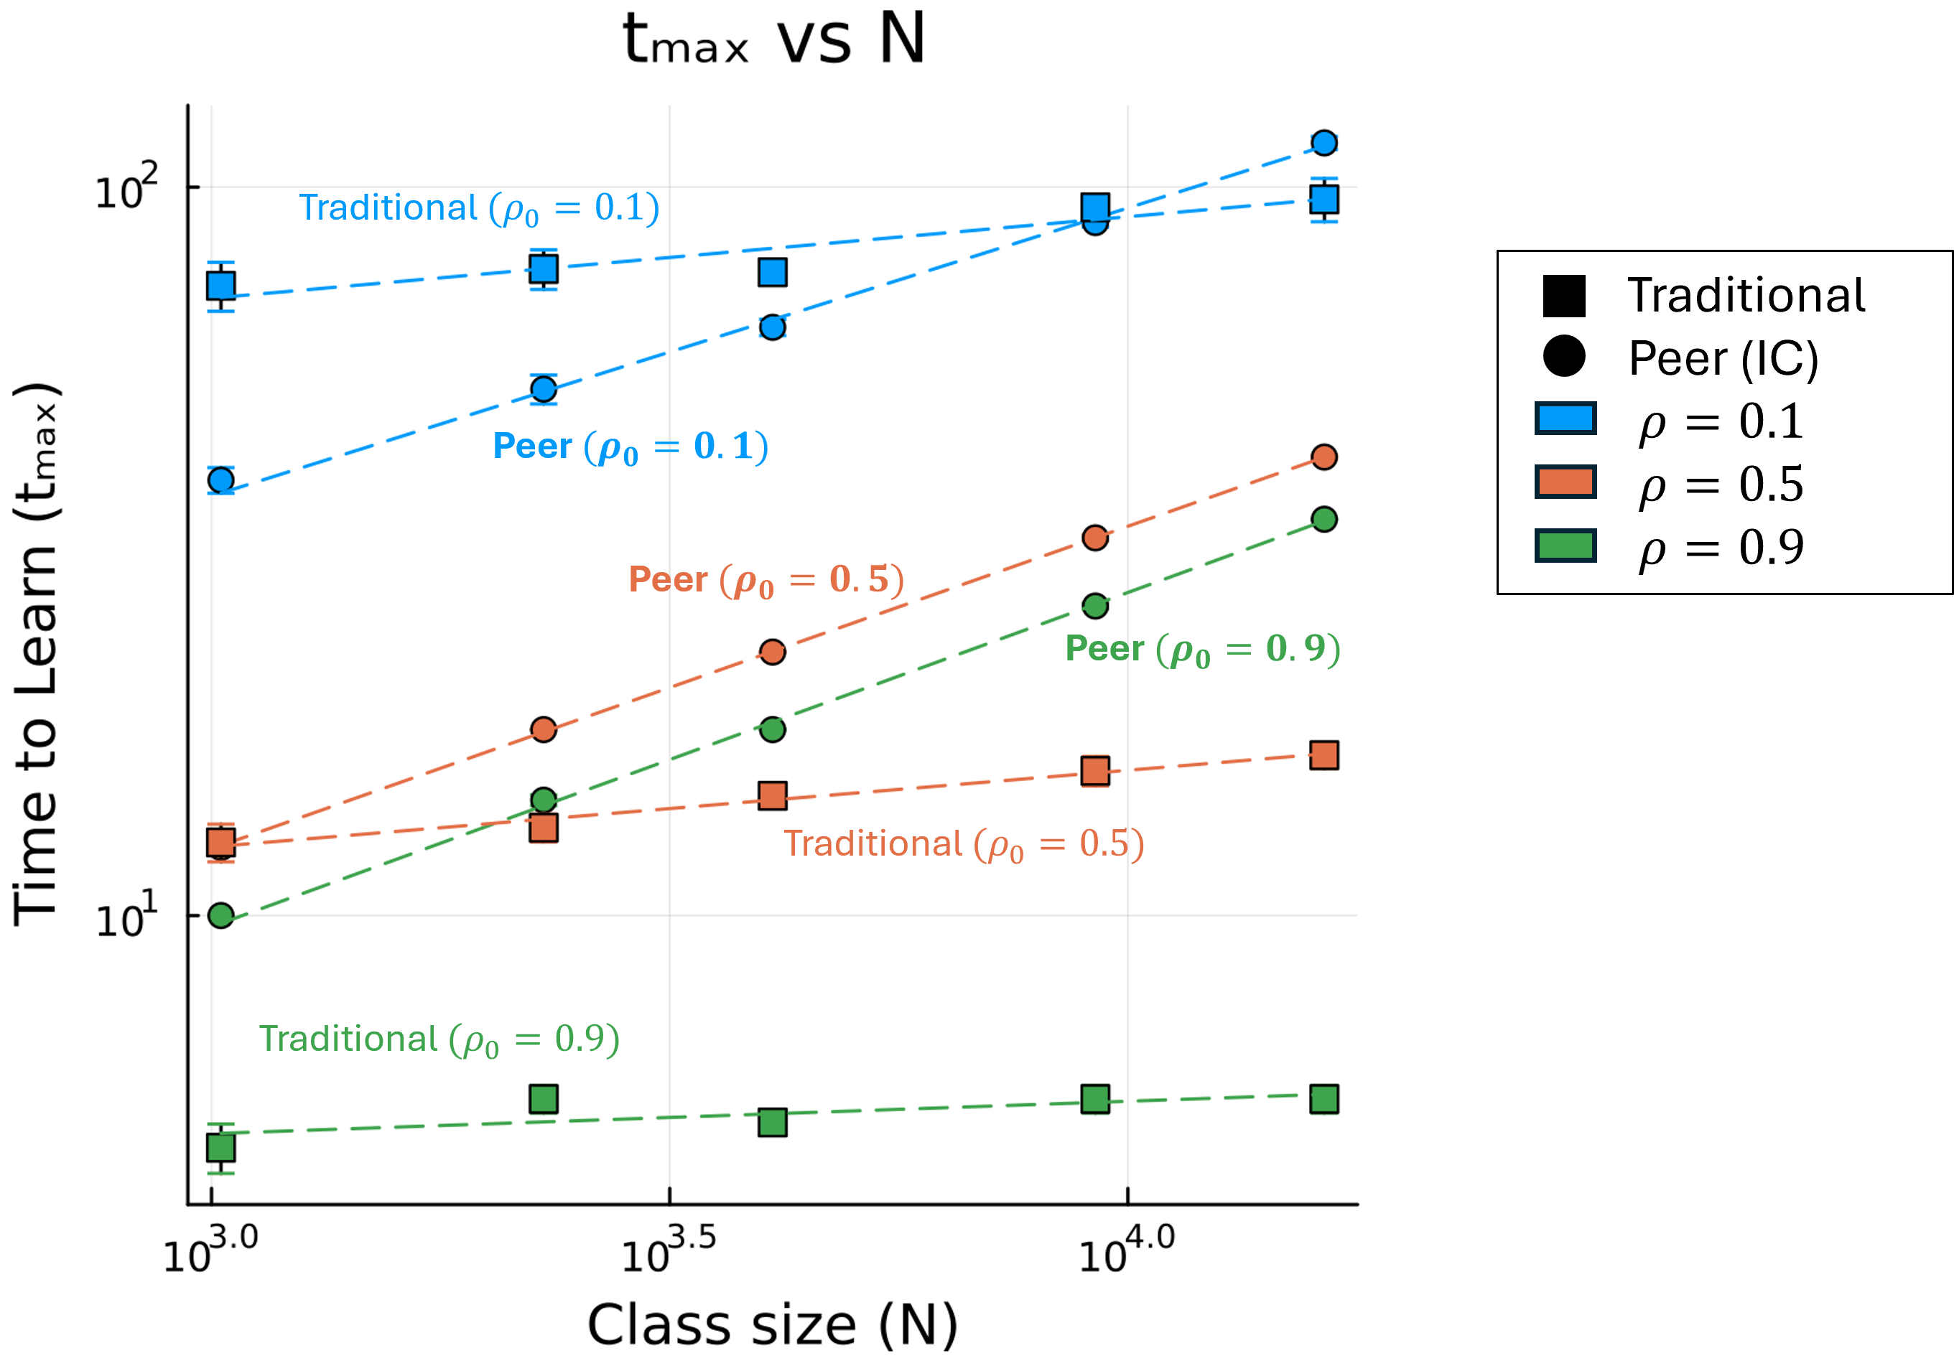
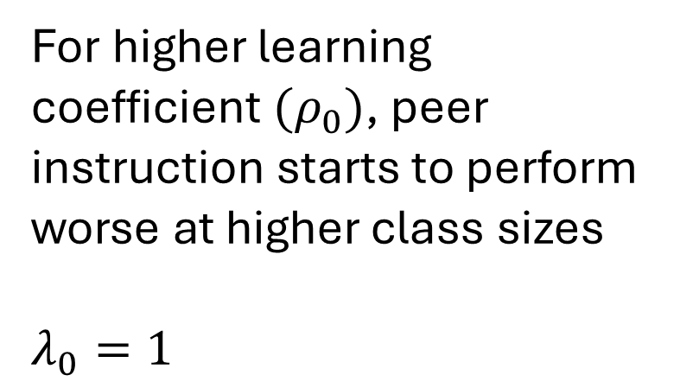
Traditional instruction does not scale with size
For higher learning coefficient $(ρ_{0})$, peer instruction starts to perform worse at higher class sizes
$λ_{0}=1$
*Lower is better

Slide 27
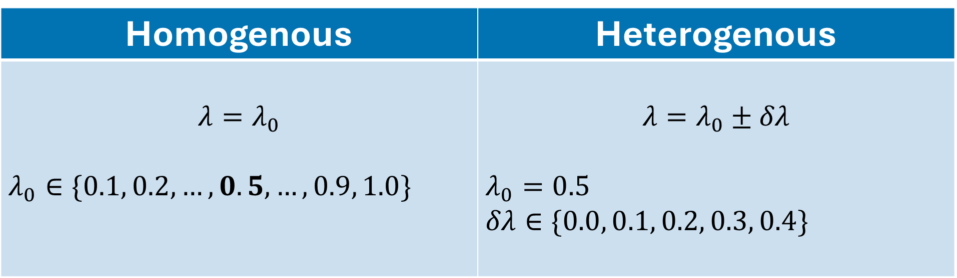
Homogenous vs heterogenous
Homogenous | Heterogenous
$$λ=λ_{0}$$ $λ_{0}∈\{0.1, 0.2, …,0.5,…, 0.9, 1.0\}$ | $$λ=λ_{0}±δλ$$ $λ_{0}=0.5$ $δλ∈\{0.0, 0.1, 0.2, 0.3, 0.4\}$

Slide 28
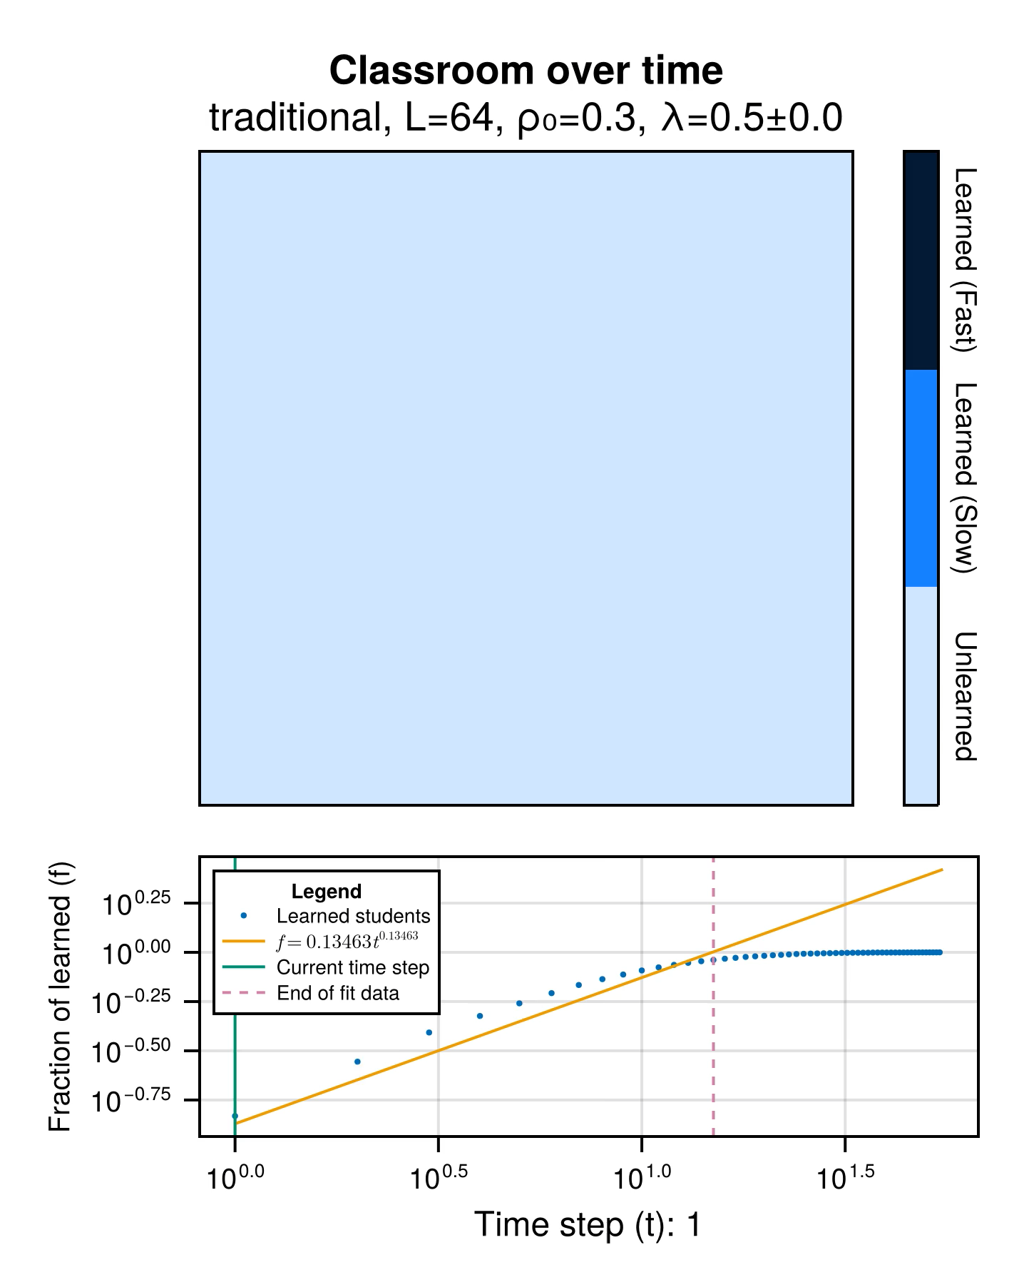
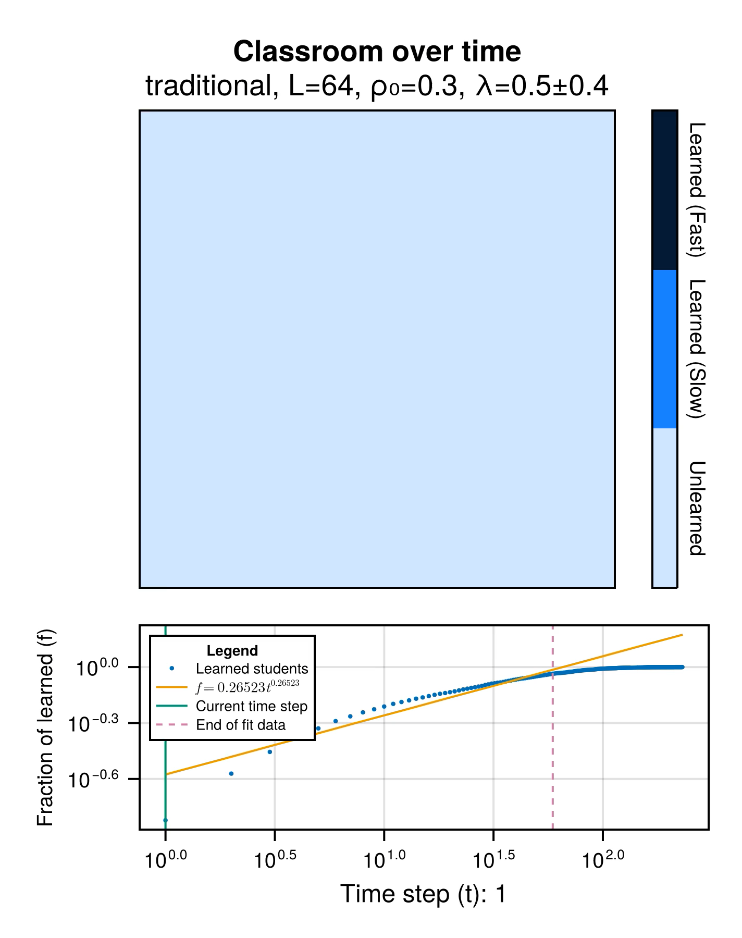
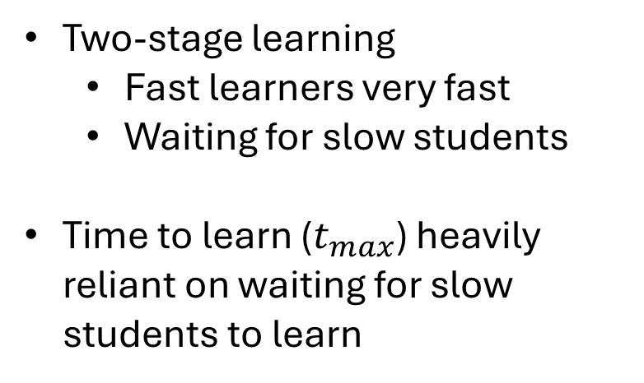
Two-stage learning dynamics for heterogenous traditional instruction
Homogenous
Heterogenous
Two-stage learning
Fast learners very fast
Waiting for slow students
Time to learn ($t_{max}$) heavily reliant on waiting for slow students to learn

Slide 29
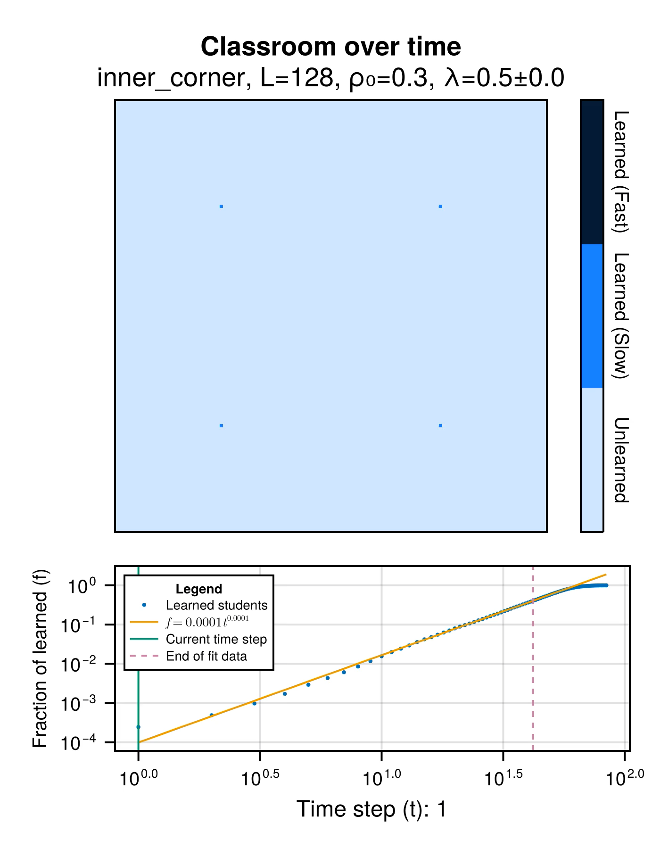
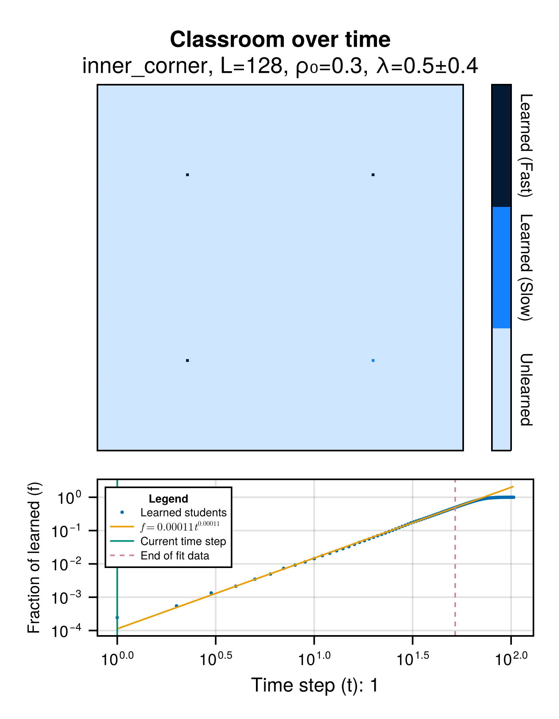
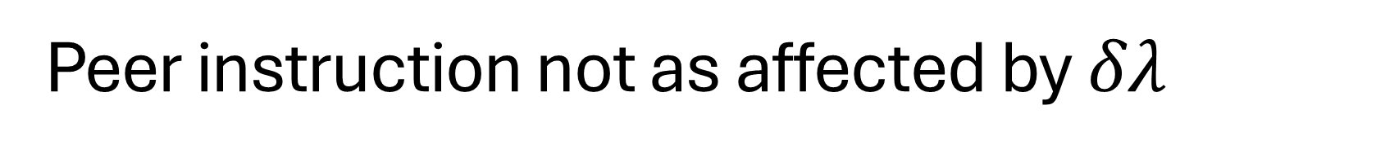
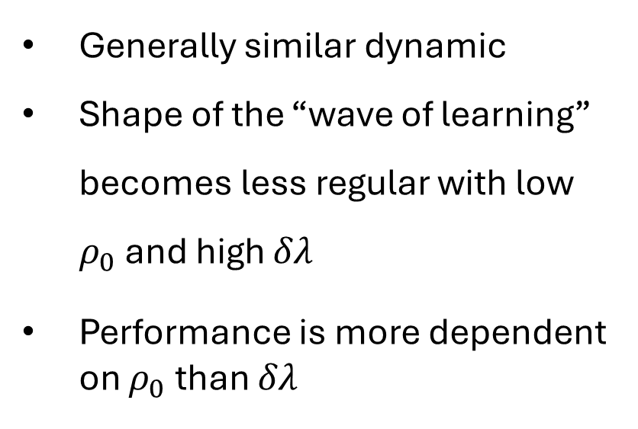
Peer instruction not as affected by $δλ$
Generally similar dynamic
Shape of the “wave of learning” becomes less regular with low $ρ_{0}$ and high $δλ$
Performance is more dependent on $ρ_{0}$ than $δλ$

Slide 30
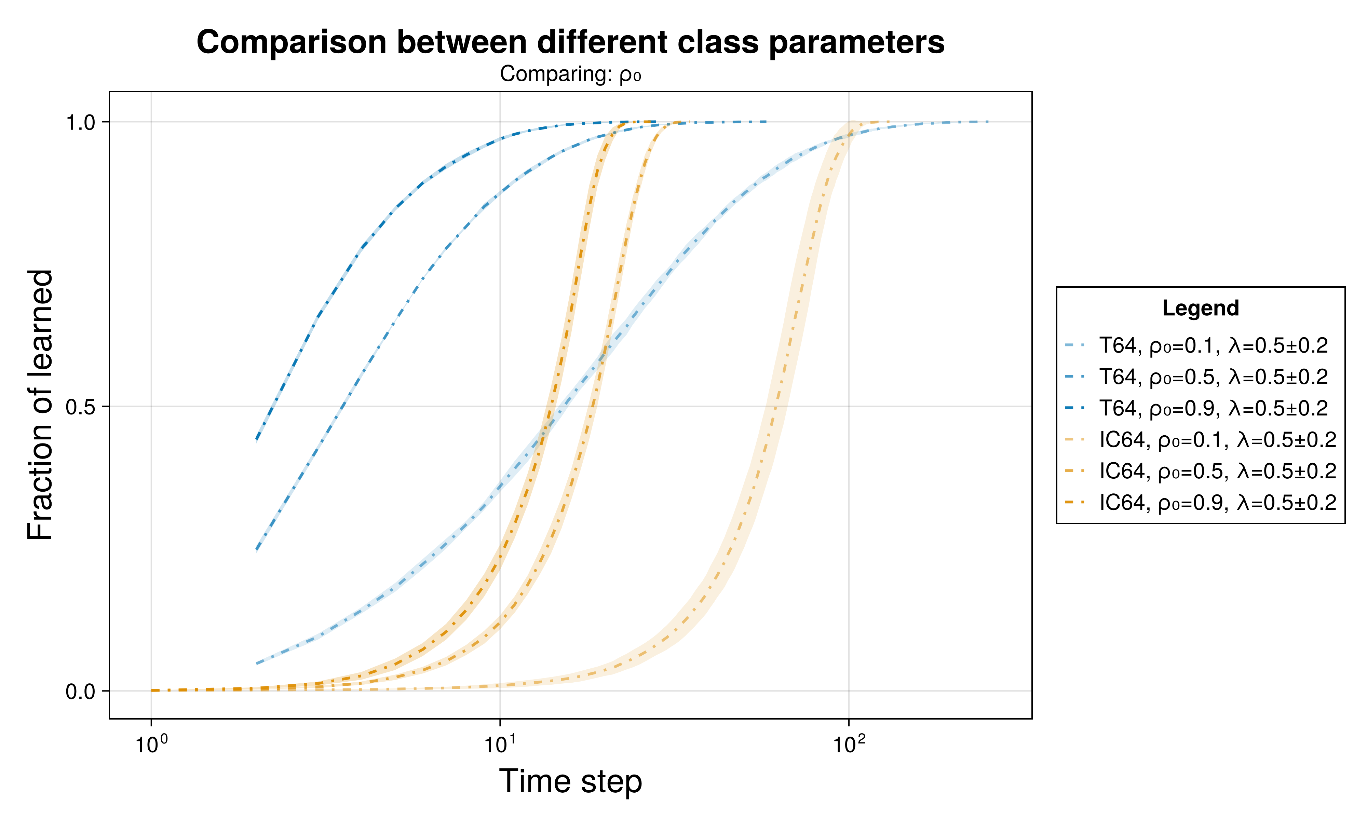
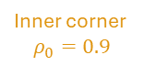
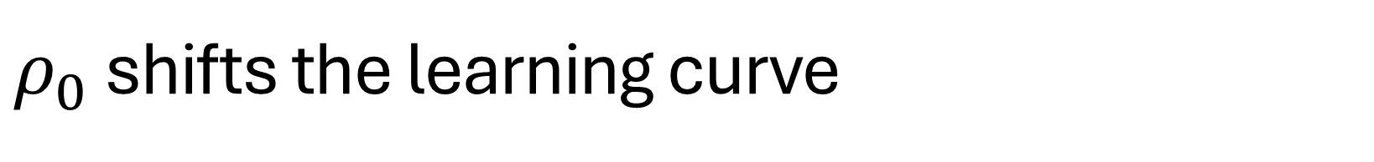





$ρ_{0}$ shifts the learning curve
Traditional
Changes initial average learning rate and initial number of learned students
Peer instruction
Horizontal shift
Traditional
$$ρ_{0}=0.9$$
Traditional
$$ρ_{0}=0.5$$
Traditional
$$ρ_{0}=0.1$$
Inner corner
$$ρ_{0}=0.1$$
Inner corner
$$ρ_{0}=0.9$$
Inner corner
$$ρ_{0}=0.5$$
$$L=64, λ=0.5±0.2$$

Slide 31







$δλ$ less impactful than $ρ_{0}$
Traditional
Minimal changes initial average learning rate
Peer instruction
Minimal horizontal shift
Traditional
$$δλ=0$$
Traditional
$$δλ=0.4$$
Traditional
$$δλ=0.2$$
Peer instruction
$$δλ=0.0, 0.2$$
Peer instruction
$$δλ=0.4$$
$$L=64, ρ_{0}=0.5, λ_{0}=0.5$$

Slide 32


Greater effect of heterogeneity on traditional instruction
*Lower is better

Slide 33

Greater effect of heterogeneity on traditional instruction
*Higher is better

Slide 34



$δλ$’s minimal effect on PI $m$ values
*Higher is better

Slide 35














Heterogenous classes lends itself to PI even when classes are large
Homogenous $(δλ=0.0)$
Highly Heterogenous $(δλ=0.4)$
Traditional $(ρ_{0}=0.1)$
Traditional $(ρ_{0}=0.1)$
Peer $(ρ_{0}=0.1)$
Peer $(ρ_{0}=0.1)$
Peer $(ρ_{0}=0.5)$
Traditional $(ρ_{0}=0.5)$
Traditional $(ρ_{0}=0.9)$
Traditional $(ρ_{0}=0.5)$
Peer $(ρ_{0}=0.5)$
Peer $(ρ_{0}=0.9)$
Traditional $(ρ_{0}=0.9)$
Peer $(ρ_{0}=0.9)$
*Lower is better

Slide 36



PI is a safe option
*Lower is better

Slide 37

Summary and conclusions
Traditional instruction | Peer instruction
More sensitive to student learning rate heterogeneity More students learn earlier compared to PI Time to learn ($t_{max}$) dependent slow learners | Less affected by student learning rate heterogeneity Dependent on classroom geometry and initial conditions Inner corner SA performs best Lower initial class learning rate $m$ Generally lower time to learn $t_{max}$ Can be a safe option

Slide 38

Comparison with other research
Limitations | Differences | Similarities
Binary state agents No similarity effect (Smith, et. al., 2009) Isotropic learning | Class learning vs individual learning Optimal seating arrangements (Roxas et. al., 2010) | Peer $≥$ traditional (Crouch and Mazur, 2001; Lasry et. al., 2008) Both methods are more effective with homogenous classes (Roxas et. al., 2010)

Slide 39
Classroom learning dynamics using a cellular automata spatiotemporal model comparing peer instruction and traditional instruction
Undergraduate Thesis Defense
National Institute of Physics
December 12, 2024, 10:30 AM
THANK YOU!!!
Clarence Ioakim T. Sy
BS Applied Physics
Instrumentation Physics Laboratory
National Institute of Physics
University of the Philippines Diliman
Adviser: Johnrob Y. Bantang, Ph.D.

Slide 40

Inner corner as the best PI seating arrangement

Slide 41

Size invariance of traditional instruction
Notes:
Left:
Size does not affect traditional
Delay ulit yung effect sa PI. Scales with size

Slide 42

Learning curves for different SAs
Notes:
Random: mixes both – least extreme of OC and C
IC: optimized
T: baseline

Slide 43


Heterogeneity effects are similar to size

